Slide 1
Research misconduct and confidence in research
ESOF, 25 June 2014
Maria Lindholm, Director of Research, VA (Public & Science)

Slide 2
Confidence in research

Slide 3
Background
Why decreased confidence in research?
Systematic content analysis of major Swedish news media (daily press and television)
Period: 2002–2013, 359 items
Researcher Ulrika Andersson, the SOM Institute (Society Opinon Media) of Gothenburg University

Slide 4
Number of articles 2002–2013

Slide 5
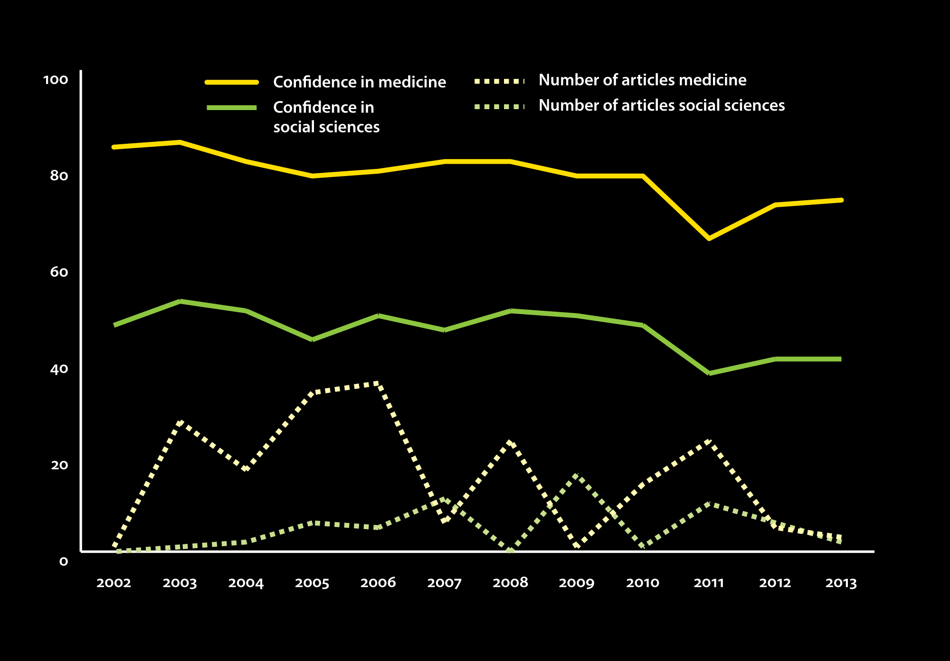
Confidence and reporting

Slide 6
Do other factors have a larger impact?
Age
Level of education
Place of residence
… and media consumption in general

Slide 7
maria@v-a.se
www.v-a.se
Twitter/FB/Instagram: vetenskapoallm
With support from

